Slide 1

Networking Basics & Security Relevance
Networking means connecting devices (computers, servers, mobiles, printers) so they can communicate and share data through the internet or a private network.

Slide 2
Main components
Devices (Computer, Server, Router, Switch)
Communication medium (Cable, WiFi, Fiber)
Protocols (rules of communication like TCP/IP)

Slide 3
Why networking is important for security:
When systems are connected, attackers can also try to access them remotely. Therefore security controls are needed.

Slide 4
Security focuses on:
Confidentiality – data should not be leaked
Integrity – data should not be modified
Availability – services should remain accessible
Real life example:- When you access online banking, your laptop connects to the bank server through many networks. If security is weak, attackers could steal login credentials or banking data.

Slide 5
OSI & TCP/IP Models (Layer-wise Threats & Controls)
These models explain how data travels through a network step by step.

Slide 6
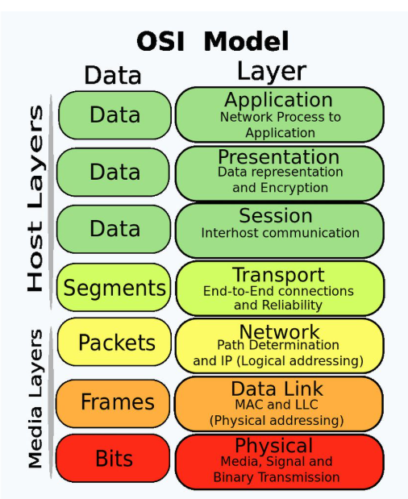
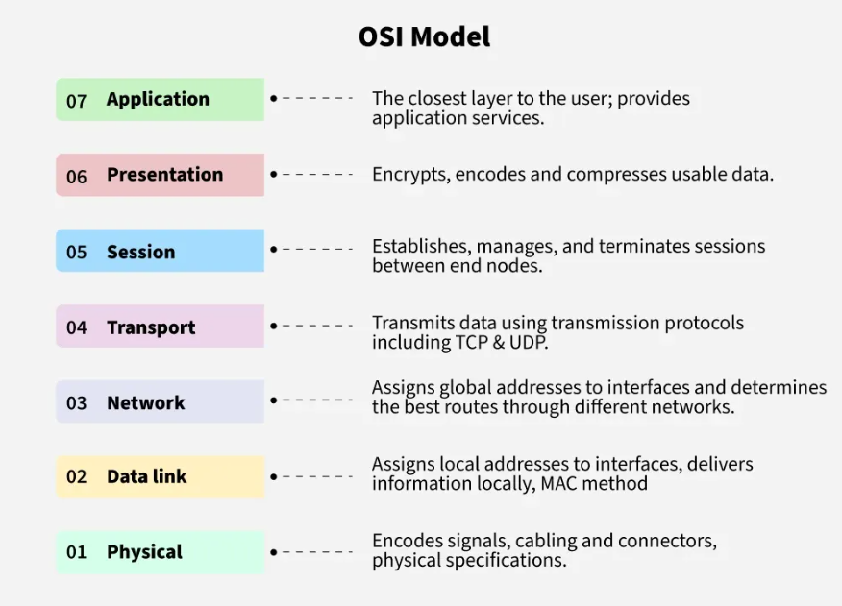
OSI model has 7 layers.

Slide 7
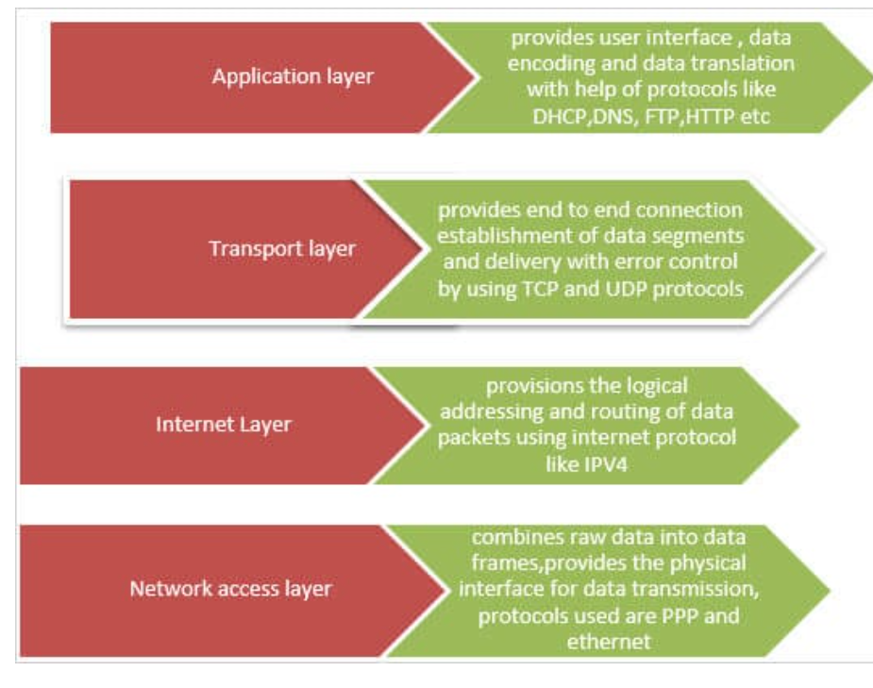
TCP/IP Model has 4 layers
1 Network Access
2 Internet
3 Transport
4 Application

Slide 8
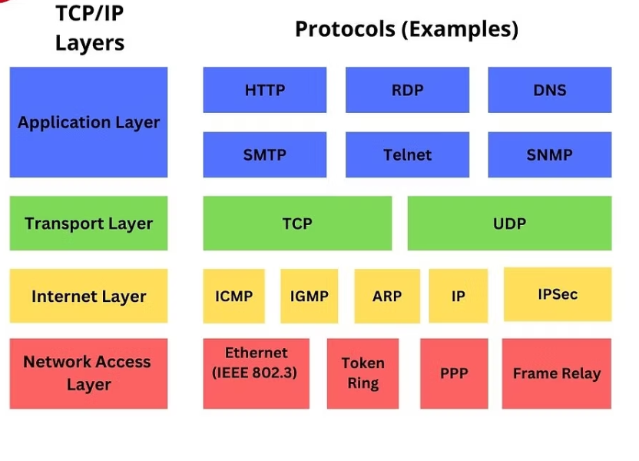

Slide 9
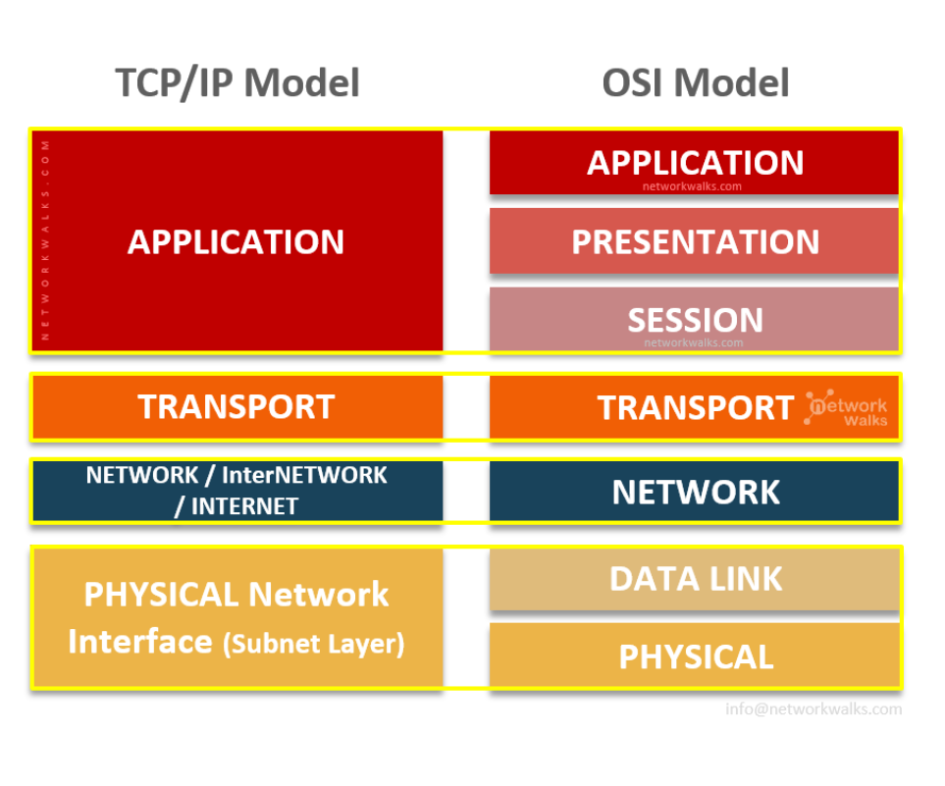
Difference Between TCP/ip And osi

Slide 10
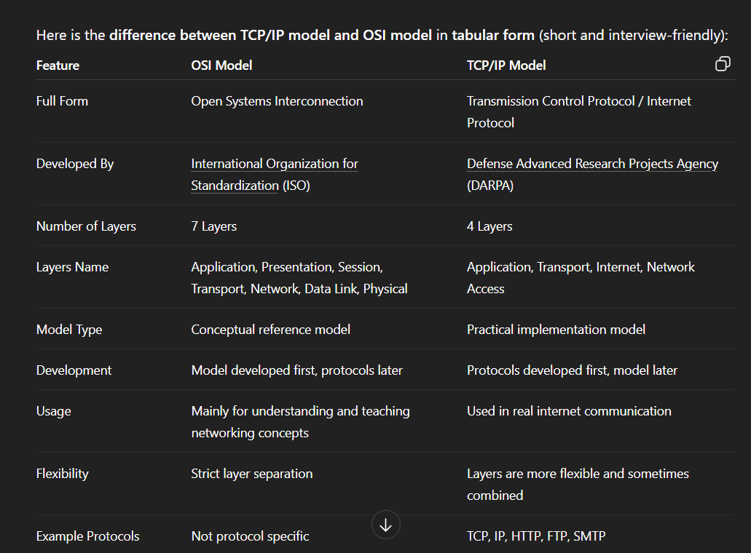

Slide 11
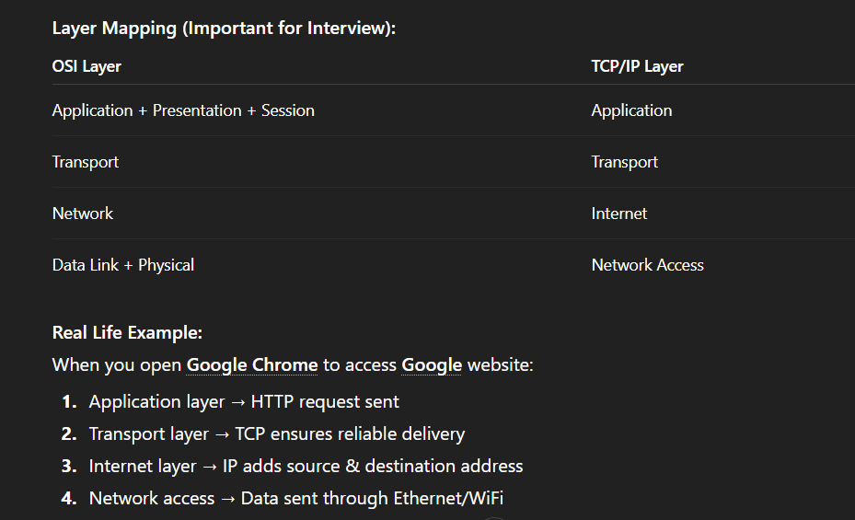

Slide 12
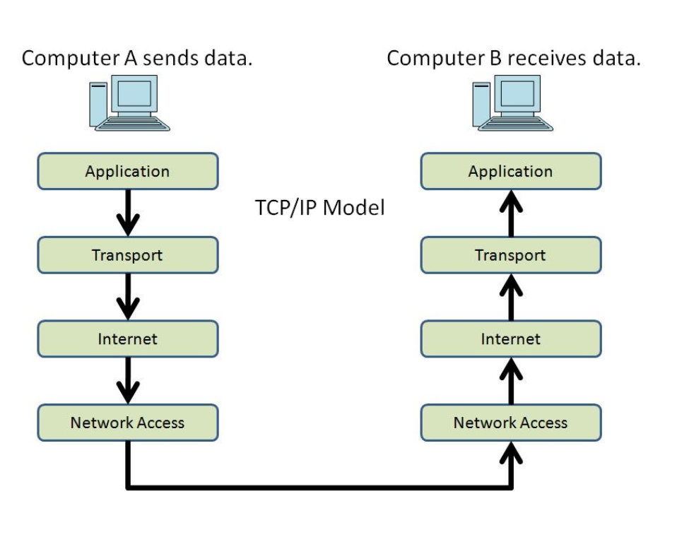

Slide 13
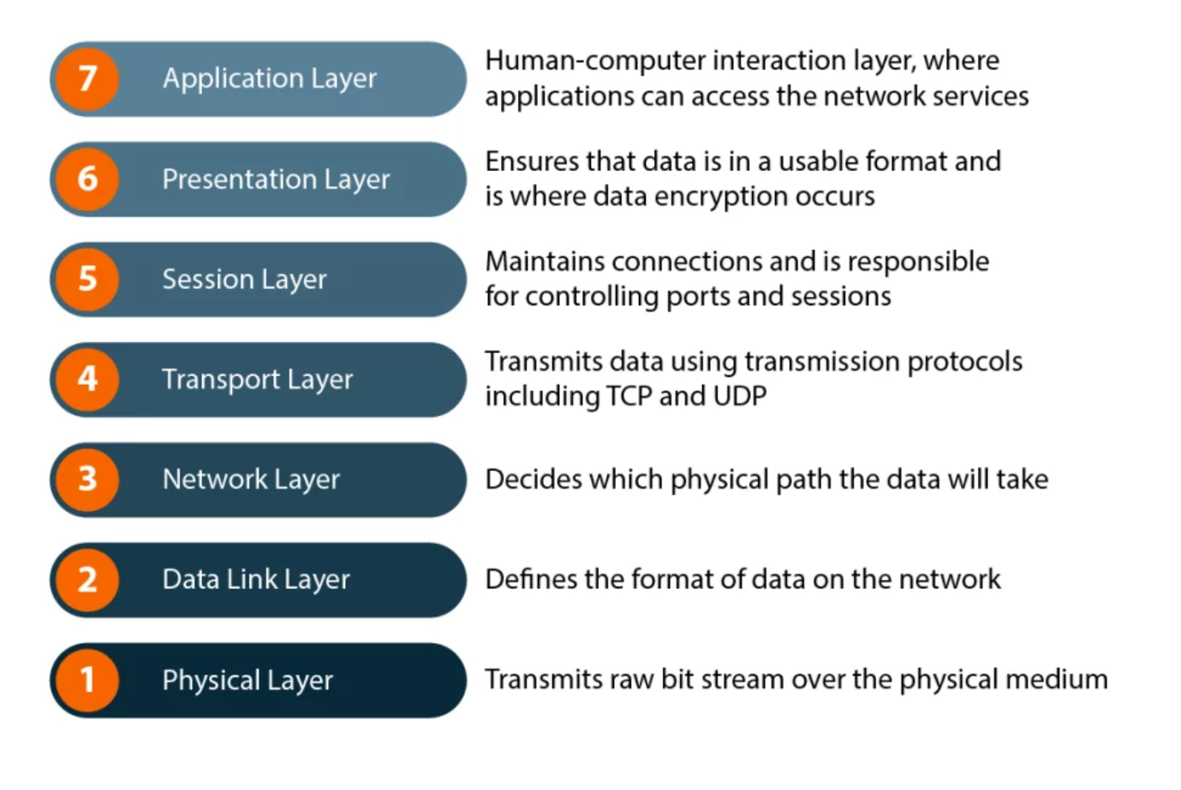

Slide 14
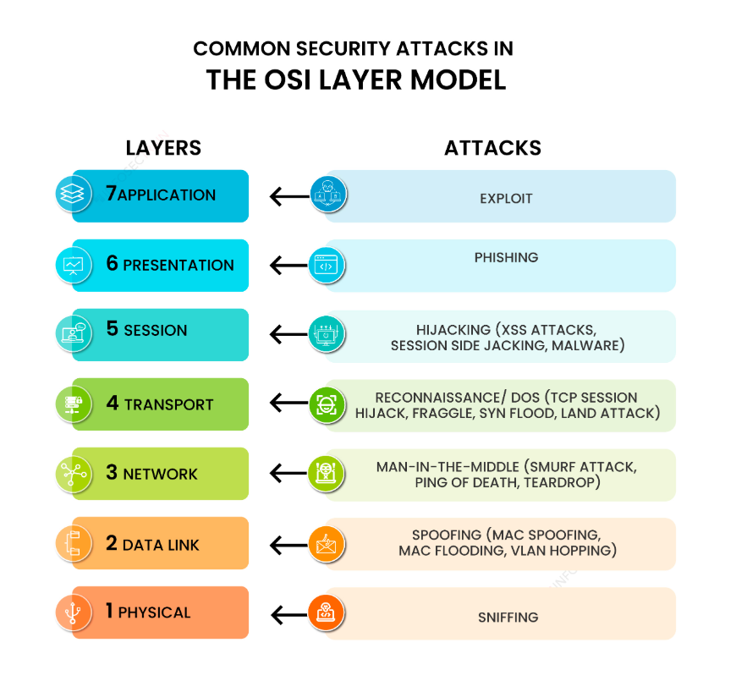

Slide 15
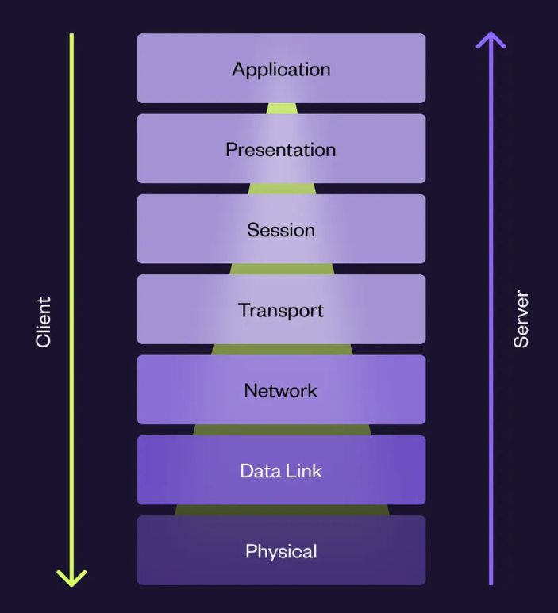
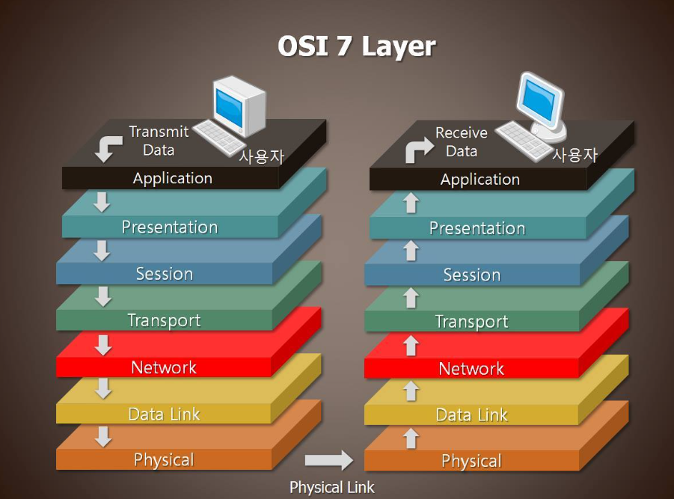

Slide 16
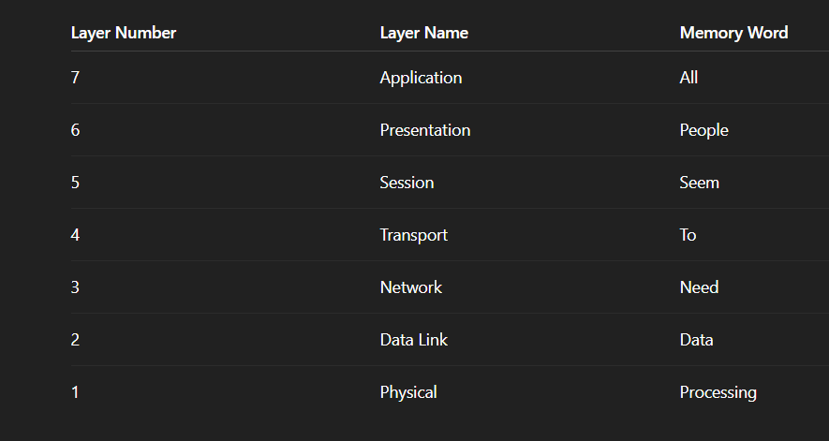

Slide 17
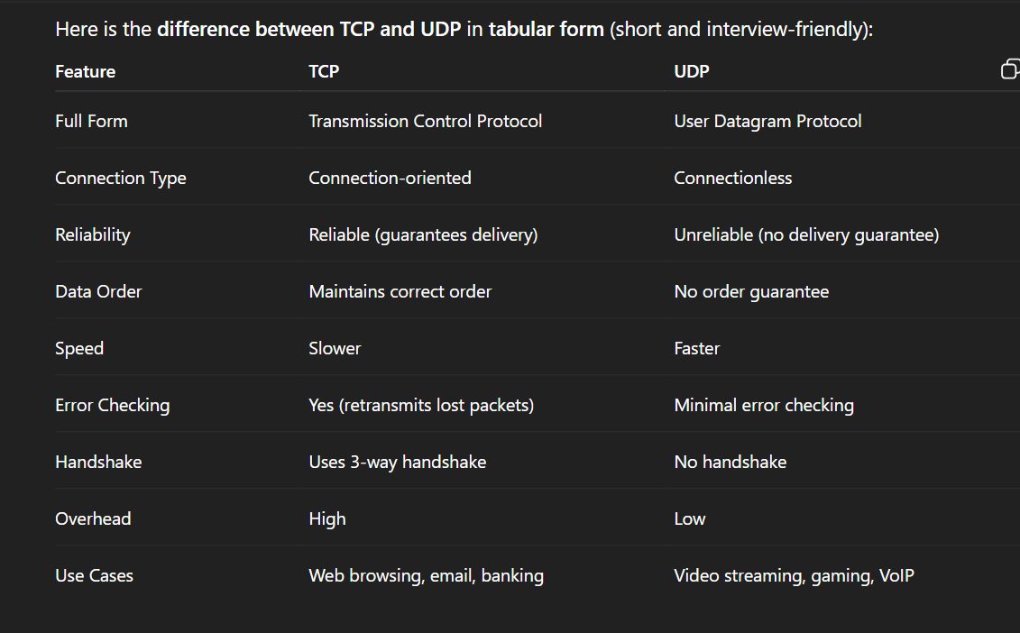
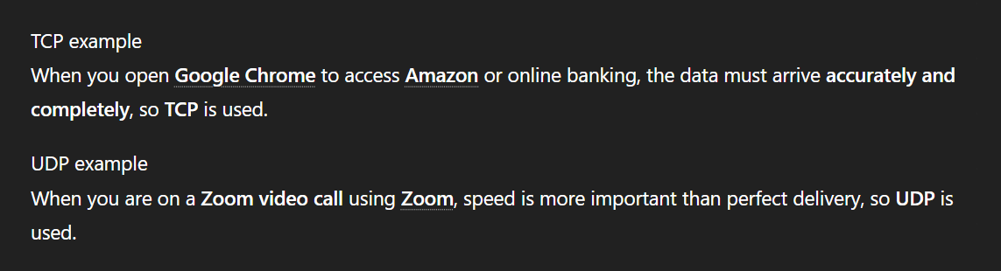

Slide 18
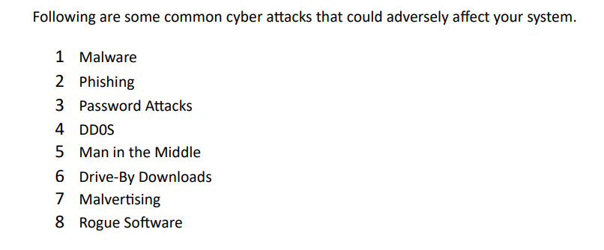
Some common cyber attacks

Slide 19
Malware
Stand for Malicious Software.
it is a harmful program created by attackers to disrupt systems, spy on users, or steal sensitive information.
Example:
If you download a fake software from the internet and it secretly steals your passwords or damages files, that program is malware.

Slide 20
Types of malware
Virus
A malicious program that attaches to files and spreads when the file is executed.
Trojan (Trojan Horse)
A program that looks legitimate but secretly performs malicious activities.
Worm
Malware that spreads automatically across networks without user action.
Ransomware
Malware that locks or encrypts files and demands payment to unlock them.
Spyware
Software that secretly collects user information like passwords and browsing data.
Adware
Software that displays unwanted advertisements on a system.
Rootkit
Malware designed to hide its presence and give attackers deep access to the system.
Real-life example:
If a user clicks on a phishing email attachment and it installs ransomware that encrypts all files and asks for payment, that is a malware attack.

